Slide 1
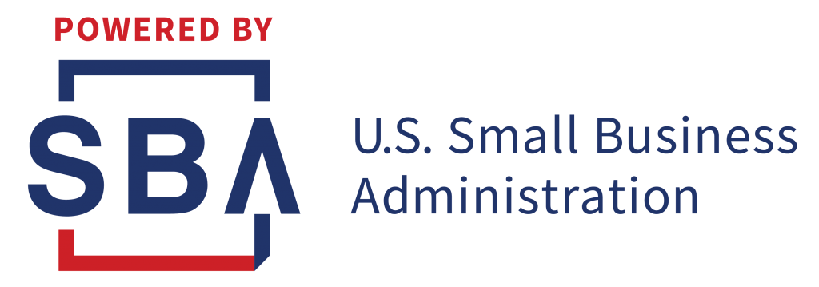
State & Federal Grant & Loan Options

Slide 2
City of Milwaukee Resources
City of Milwaukee Business Restart Grants
Up to $15,000 grant
Companies under 20 employees
Applications not yet available

Slide 3
Wisconsin Resources
https://wisconsinsbdc.org/services/covid-19
Small Business 20/20 Program - $20K Grant (2 Months Payroll & Rent). Need to be a current loan holder of WWBIC (Wisconsin Women’s Business Initiative Corporation – wwbic.com) or MEDC (Milwaukee Economic Development Corporation – medconline.com)
Announced 5-19-20. Companies up to 20 full time employees & under $2 million in revenue are eligible for a one-time state grant of $2,500. Applications available in June.

Slide 4
Federal SBA Resources
Federal Disaster Loan
https://covid19relief.sba.gov/#/ - not through a SBA lender bank
Can apply to receive UP TO $10K emergency advance that could then be given as a grant. $10K Grant link is: https://covid19relief.sba.gov/#/ (applications currently not being taken as the program is underfunded)
Loans under $200K do not require a personal guaranty
No payments, interest for 12 months
Interest rate is 3.75%, up to 30 years amortization

Slide 5
Federal SBA Resources
However, the EIDL program is having large problems as over 4 million companies have applied for funding
SBA changed direction and instead of a $10K grant it’s a grant of $1,000 per employee UP TO $10K & will take several weeks to process
Instead of up to a $2 million loan – loans right now are capped at $150K and will take 30 to 45+ days to process.

Slide 6
Federal SBA Resources
Entities applying for loans under the Disaster Loan Program in response to COVID-19 may, during the covered period, request an emergency advance from the Administrator of up to $10,000, which does not have to be repaid, even if the loan application is later denied. The Administrator is charged with verifying an applicant’s eligibility by accepting a “self-certification.” Advances are to be awarded within three days of an application.
Advances may be used for purposes already authorized under the SBA Disaster Loan Program, including:
Providing sick leave to employees unable to work due to direct effect of COVID-19;
Maintaining payroll during business disruptions during slow-downs;
Meeting increased supply chain costs;
Making rent or mortgage payments; and
Repaying debts that cannot be paid due to lost revenue.

Slide 7
Federal SBA Resources
CARES ACT Convertible Grant – Paycheck Protection Program
https://www.sba.gov/funding-programs/loans/paycheck-protection-program
Up to 100% can be turned into a grant (convertible loan)
Treasury secretary claims these will be processed and funded within one day
Here’s the formula for what you can get….

Slide 8
Federal SBA Resources
Formula:
What’s your average monthly payroll including all taxes over the past 12 months
What your average monthly cost for healthcare, dental, vision, retirement (any benefits you give your employees)
Take that monthly average the multiply by 2.5
This is the amount of your convertible grant

Slide 9
Federal SBA Resources
How Loan Forgiveness Will Likely Work (source: senior Treasury & SBA Officials)
Loan forgiveness will apply so long as your employees are rehired by June 30th. Use 75% of your proceeds for payroll (this guidance may change)
Amount forgiven is not treated as taxable income
Reasonable that banks will fund you within a few business days
Guidance on how you use your funds has been literally changing each hour for the past two days – expect more changes.

Slide 10
Federal SBA Resources
Dates:
Small Businesses & Sole Proprietorships Can Start Applying on April 3rd
Independent Contractors & Self-Employed Can Start Applying on April 10th
Apply Right Away – There is a Funding Cap!
Application is 1 Page Only! Should Take 3 Minutes To Apply!

Slide 11
Federal SBA Resources
What you can use the funds for:
Payroll
Rent or Mortgage on Business
Business Utilities
Employee Benefits
Interest on Existing Business Loans

Slide 12
Federal SBA Resources
‘Covered Period’ = February 15 to June 30
You need to track what you spent money on
Are you doing your best to maintain and re-hire employees?
You will need to provide documentation to the SBA so your funding is turned into a grant (forgivable loan)

Slide 13
Federal SBA Resources
Payroll Tax Relief
You can forgo paying any further payroll taxes for your employees for the rest of 2020
This is not a waiver of payment - this is still owed in the future
50% must be repaid in 2021
50% must be repaid in 2022

Slide 14
State Future Resources
Leadership of both parties and Governor are working on a package to fill gaps of the CARES Act for small business
Ideas include:
Wisconsin Payroll Tax Holiday
Grant Gap for Reduced Payroll Formula of CARES Act Convertible Grant
Unemployment Insurance Tax Holiday
Sales Tax Holiday
Real Loan/Grant Opportunities

